Slide 1

ENSO in a Changing Climate
CLIVAR Research Focus Group
Co-chairs: Eric Guilyardi (IPSL, NCAS-Climate), Andrew Wittenberg (GFDL)
With contributions from:
Mat Collins (Uni Exeter), Wenju Cai (CSIRO), Tony Lee (JPL), Mike McPhaden (PMEL)
Pan-CLIVAR meeting The Hague, The Netherlands
July 2014

Slide 2
ENSO in a Changing Climate
Major Rationale
Despite 30 years of progress, ENSO continues to surprise us and challenge our assumptions. It remains a major unsolved climate puzzle with enormous societal impacts, including the understanding of the regional impacts of climate change.
Operational need: there has been a lack of recent progress in seasonal prediction (e.g., an apparent reduction of forecast skill since the 2000s).

Slide 3
ENSO in a Changing Climate
Ongoing community activities & readiness
Strong momentum in the community to study ENSO mechanisms, teleconnection, diversity and impacts (large volume of literature on these topics in the past 4-5 years; a very active series of CLIVAR sponsored workshops and an on-going US CLIVAR Working Group on these topics).
An increasingly large number of studies of ENSO using CMIP5 models and how ENSO may change in a warming world.

Slide 4
Areas primed for progress in the next 5-10 years of CLIVAR
Improve the understanding of different physical processes that influence ENSO characteristics (frequency, amplitude, diversity,…).
Synthesize existing ENSO evaluation methods in GCMs including bridges to theory and use of initialised simulations.
Propose ENSO evaluation protocols and develop a strategy for coordinated ENSO analysis/metrics of CMIP models; develop and maintain an interactive website (including contribution to CMIP6).
Sustain observing systems for ENSO research and prediction; and identify new observations needed to better constrain ENSO processes, both for the current climate and for past climates.
Improve the understanding of how ENSO might change in the future.
Enhance international collaboration between observationists and modelers for studies of ENSO
Enhance applications of ENSO analysis and forecast products for targeted user communities.
Build research capacity by contributing to the development of the next generation of talents dealing with ENSO science and prediction.

Slide 5
CLIVAR ENSO Research Focus Group
Proposed actions
Processes responsible for ENSO characteristics (workshop)
Model ENSO evaluation protocol (web site and resource for model developers)
ENSO in a changing climate (review paper, update of Collins et al. 2010)
Research capacity and community building (ENSO summer school)
+ possibly an ENSO-MIP proposal for next CMIP phase

Slide 6
Processes responsible for ENSO characteristics
Basic research on ENSO
Impacts of ENSO depend on multiple characteristics (amplitude, location and extent of anomaly, timing,…)
Better understand and anticipate ENSO diversity (in observations and models)
New exciting work on ENSO low frequency variability and ENSO extremes
Initialised simulations used as diagnostic tool
Convene workshop in 2015/2016

Slide 7
Model ENSO evaluation protocol
List existing ENSO evaluation methods
Convene focused experts workshop (followed by a series of video/telephone conferences of a core group) to
  Define steps to compare methods and identify potential gaps,
  Propose an ENSO evaluation protocol for CGCMs,
  Review observations available and those missing and
  Apply protocol to CMIP
  Contribute to CMIP metrics panel effort
  Provide web site to compute the metrics/analysis required for the protocol

Slide 8
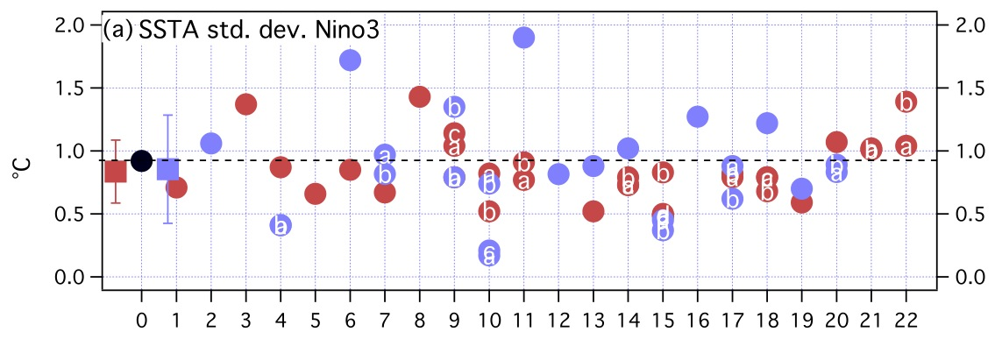
El Niño in coupled GCMs - amplitude
Standard deviation SSTA (C) in Niño3
CMIP3
CMIP5
obs
ENSO Amplitude
Modelling centers
ENSO amplitude in CMIP3: very large diversity of simulated amplitude
Range reduced in CMIP5 (improved mean state ? tuned in modelling development process ?)
Bellenger et al. (2013)

Slide 9
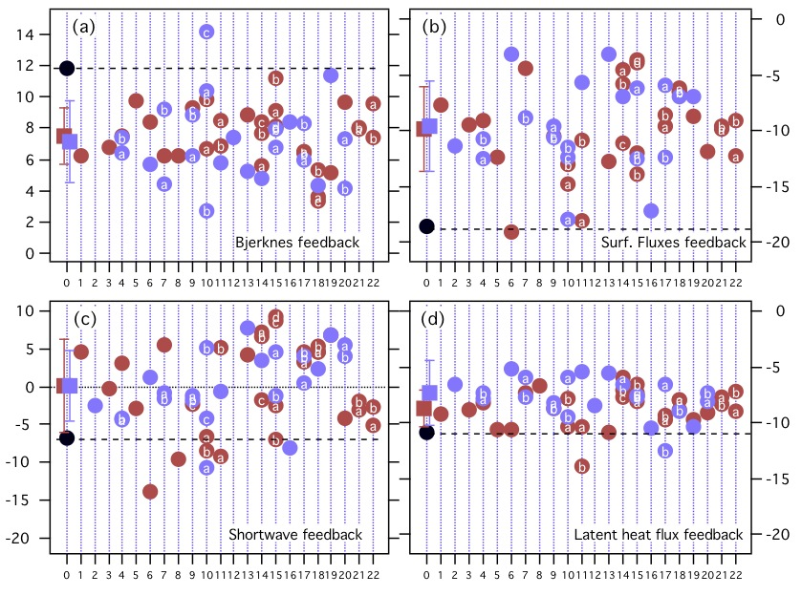
Atmosphere feedbacks in CMIP3/CMIP5
α
μ
Total Heat Flux
Bjerknes
αSW
SW Heat Flux
αLH
Latent Heat Flux
(W.m²/C)
Models underestimate both μ and α (error compensation)
Shortwave feedback αSW main source of errors and diversity
Errors in cloud response to dynamics and (low) cloud properties
No clear evolution from CMIP3 to CMIP5
Bellenger et al. CD (2013),
based on Lloyd et al. (2011, 2012)

Slide 10
ENSO in a changing climate
Analyse CMIP scenarios to better understand for ENSO changes in the future.
Use innovative approaches such as Bayesian methods and the use of ENMICS to emulate possible ENSO changes.
Explore possibility of a coordinated set of model experiments and/or coordinated set of model diagnostics to test hypotheses about future changes in ENSO.
Deliverable: peer review paper on ENSO in a changing climate providing latest estimates of likely ENSO changes over the next few decades.

Slide 11
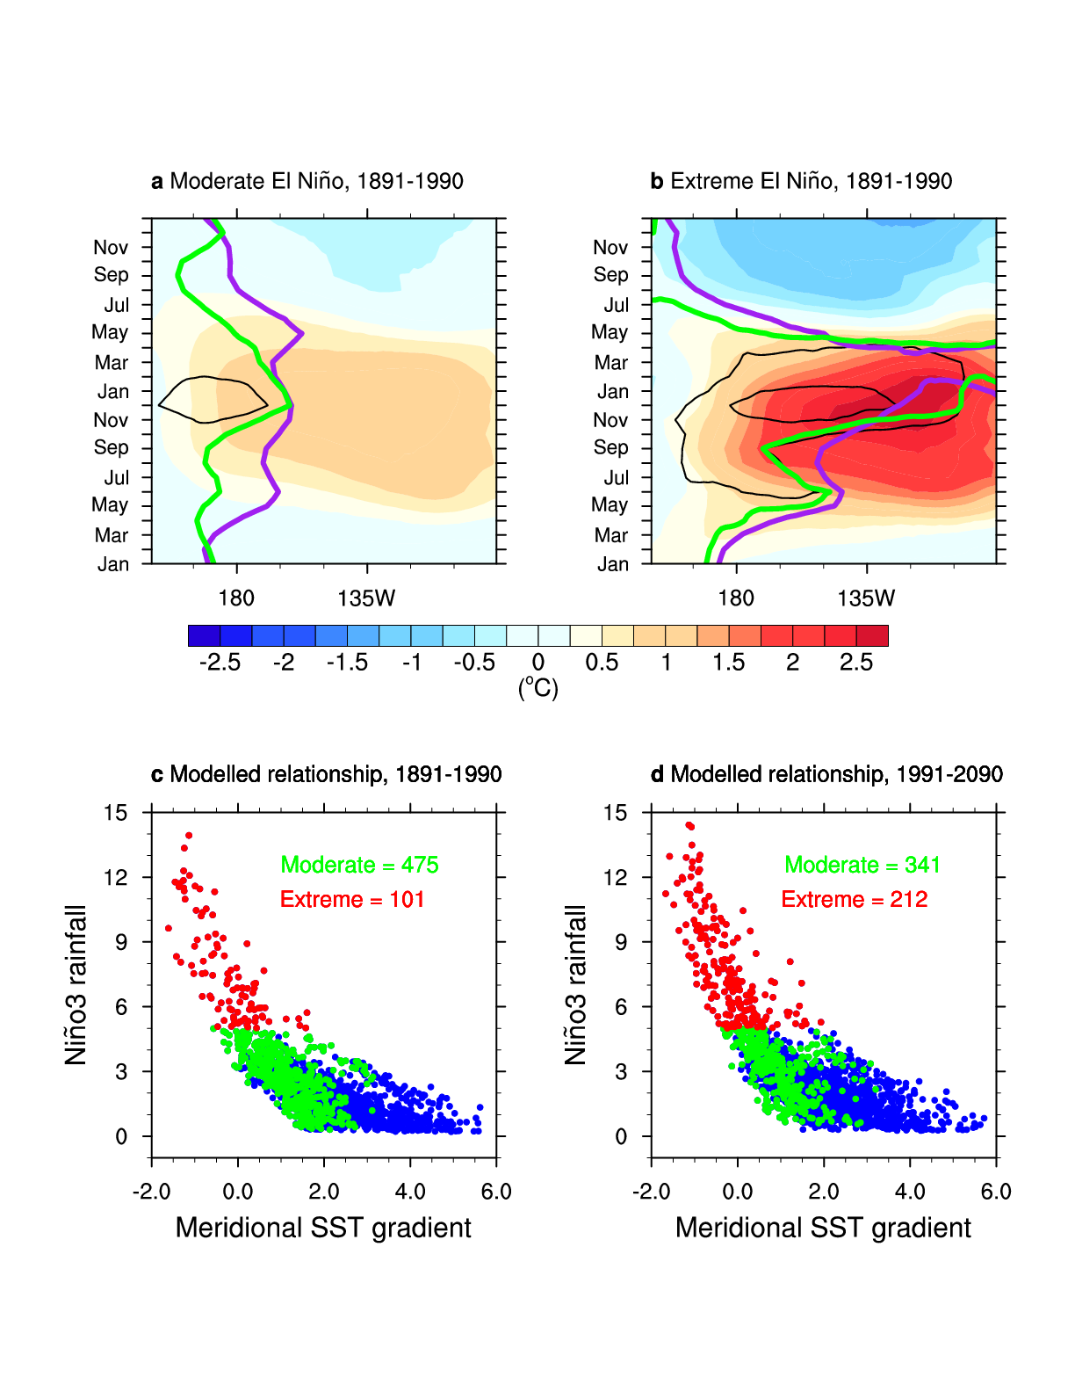
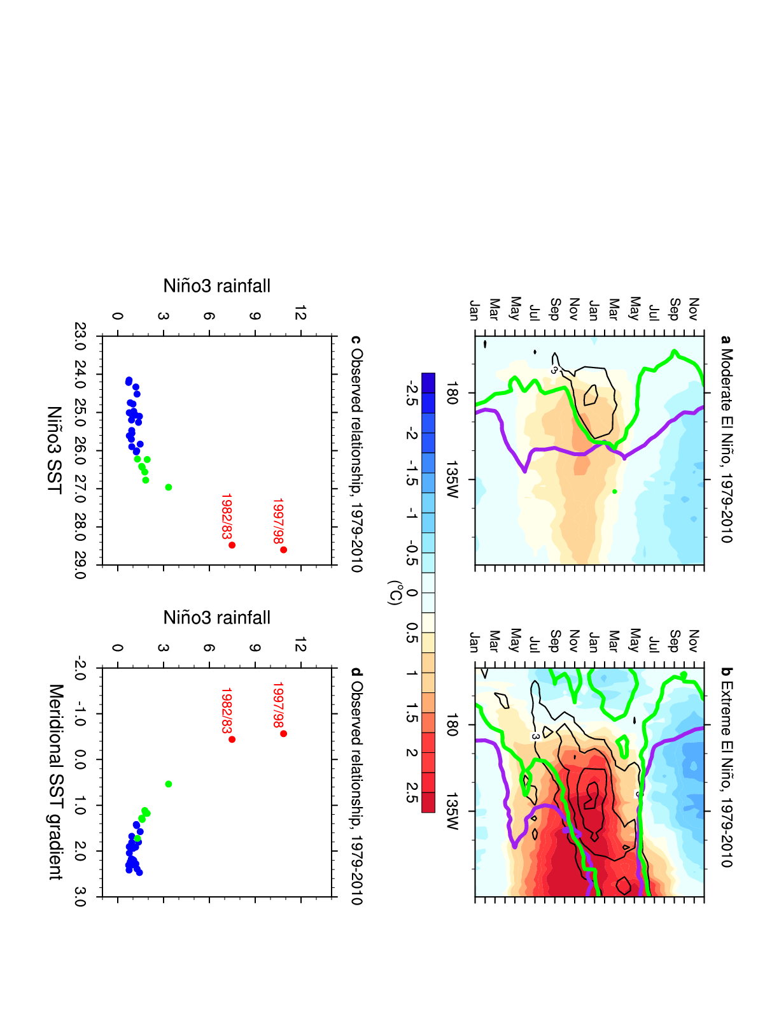
ENSO extremes increase in a warming climate
Still no model agreement on mean amplitude change in future (IPCC AR5)
Extreme El Niños have the largest impact and have distinctive SST gradients signature
Observations (1979-2010)
CMIP3 + CMIP5 models
5 mm/day
Time
SST Anomaly
Doubling of occurrence of extremes
(RCP8.5)
Cai et al. Nature CC (2014)
20th C = 17%
21st C = 38 %

Slide 12
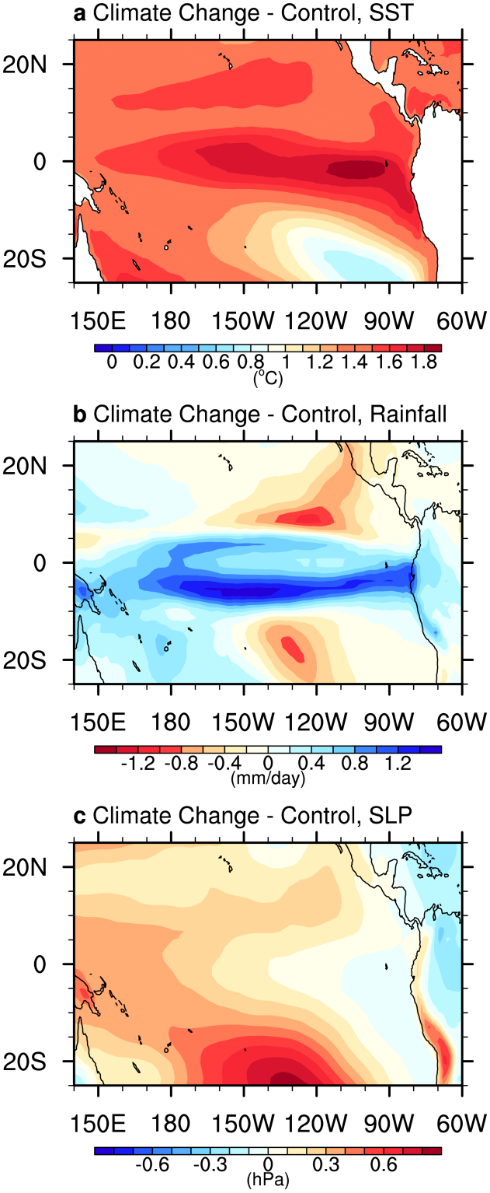
ENSO extremes increase in a warming climate
Projected surface warming over the eastern equatorial Pacific occurs faster than the surrounding ocean waters
Reduced meridional gradient of SST
More occurrences of atmospheric convection in the eastern equatorial region
Increased occurrence of extreme El Niño
Cai et al. Nature CC (2014)
21st C = 38 % !!!

Slide 13
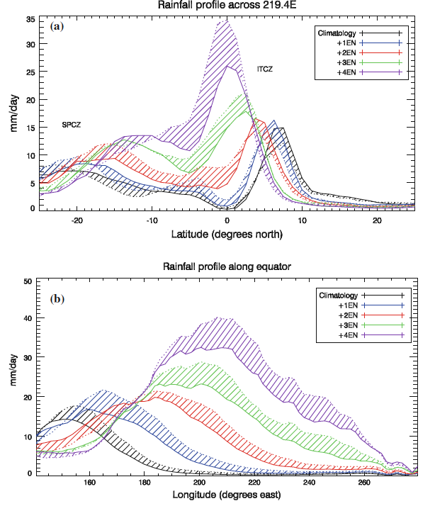
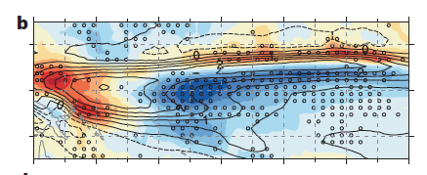
Changing El Niño Teleconnections
Chung, Power, Arblaster, Rashid, Roff, Climate Dynamics, 2014
CMIP5
Power, Delange, Chung, Kociuba, Keay, Nature 2013
Atmosphere model simulations

Slide 14
Proposal for an ENSOMIP
Building on partial coupling and hindcasts, develop a protocol to identify the source of errors in the tropical Pacific.
Characterise biases in a 10-member free-running ensemble of all-forcing runs, 1979-present.
Repeat (1), but with 5-day restoring of model SST toward observed interannually-varying SST. [To isolate the impacts of coupled SST biases on AGCM, ocean biases driven by ocean dynamics errors and forcing errors from AGCM]
Repeat (2) but with a flux adjustment (FA) diagnosed from the the restoring term in (2). [To help diagnose how climatological SST biases affect ENSO]
Retrospective 10-member, 1-year forecasts over 1979-present, using initial conditions obtained from (2), for both the non-FA and FA models. [to help isolate the seeds & amplifiers of model biases, provide an estimate of the impact of initialization (characterizing ENSO "memory"), how do biases affect initialization shock and ENSO forecast skill.]

Slide 15
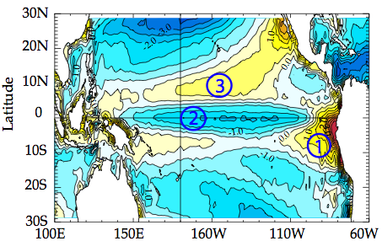
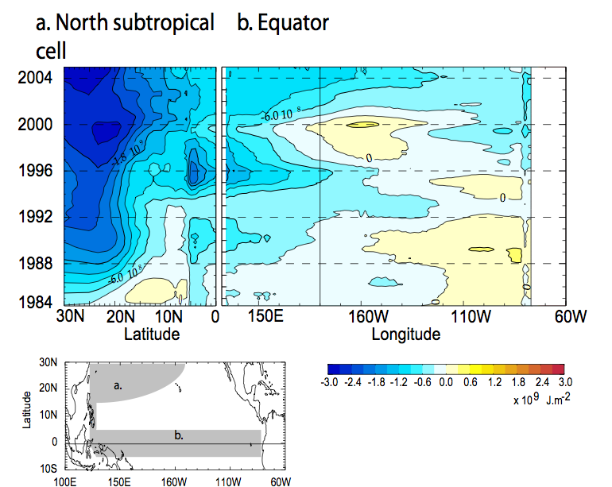
Using initialised simulations to understand model errors
Vannière et al. Clim Dyn (2014)
Associated experiments
Protocol
Q1. Spatial pattern/seasonality ?
Q2. Time scale / chronology/ propagation
Q3. Local or remote?
Q4. Atmospheric / oceanic field responsible for the biais
Q5. Direct effect / amplificationby coupled feedbacks
IPSL-CM5 cold tongue has mid-latitude origin
Historical or control experiment
Seasonal to decadal hindcasts
Regionally restored experiments
Ocean-only forced experiments
Where as cold tongue origin is:
  Bjerknes feedback (Met Office)
  Atmospheric component wind errors (INGV)
Notes:
15

Slide 16
Research capacity and community building
There is a need for a strong capacity building component to support young scientists training.
Invite selection of young scientist to workshops held and by organising an ENSO summer school for graduate students (following the successful 2009 Pacific Panel ENSO summer school). Also, it is important to enhance general public information on basic knowledge of ENSO and analysis of ENSO in models, and this could be done via web site and blogs.

Slide 17
Discussion points
Scope of ENSO RFG
Timeline
Funding (WCRP/CLIVAR and local)
CMIP6 ENSO MIP
Next steps

